Slide 1


Cyclistic [Bike Company]

Slide 2
Project Purpose
To understand how casual riders and annual members use Cyclistic bikes differently. From these insights, your team will design a new marketing strategy to convert casual riders into annual members why will be approved by the Cyclistic executive team
The Purpose of this project is to find understand how Cyclistic customers make use of the service the company provides AND to convert current casual users (Casual) into subscription membership (Members).

Slide 3
The challenge
My findings should help the company know how the two types of users use their services and how best to convert casual riders to annual members

Slide 4
Hypothesis
Based on a glance at the data, it appears as the causals use bikes for leisure purposes whiles members use bike for commute

Slide 5
Findings / matrix
Average Rides
Length of Rides
Average of rides per day of the week (Monday being day 1)
Time of rides
Rides per Season

Slide 6
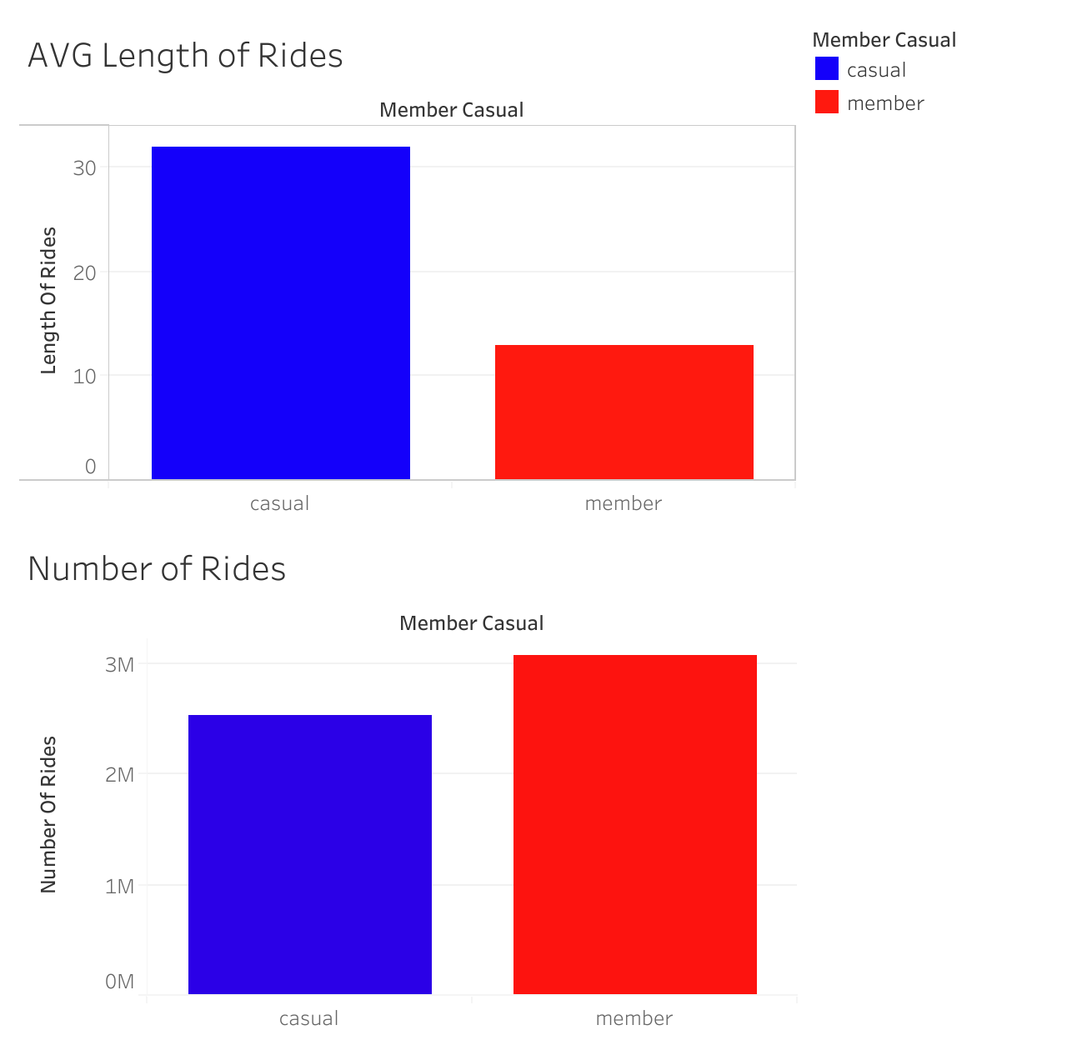
Average and Length of Rides

Slide 7
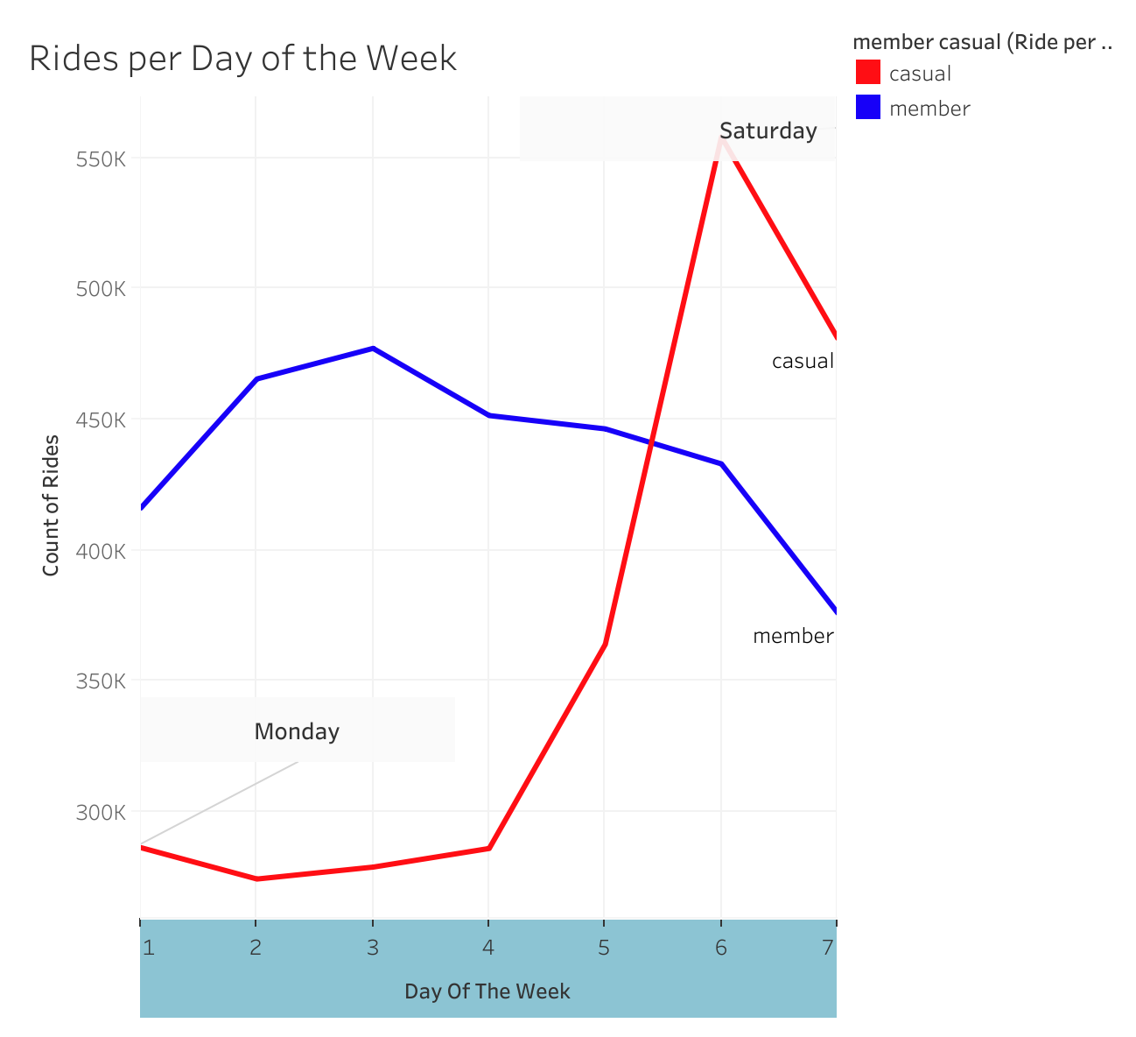
Ride per day of the week

Slide 8
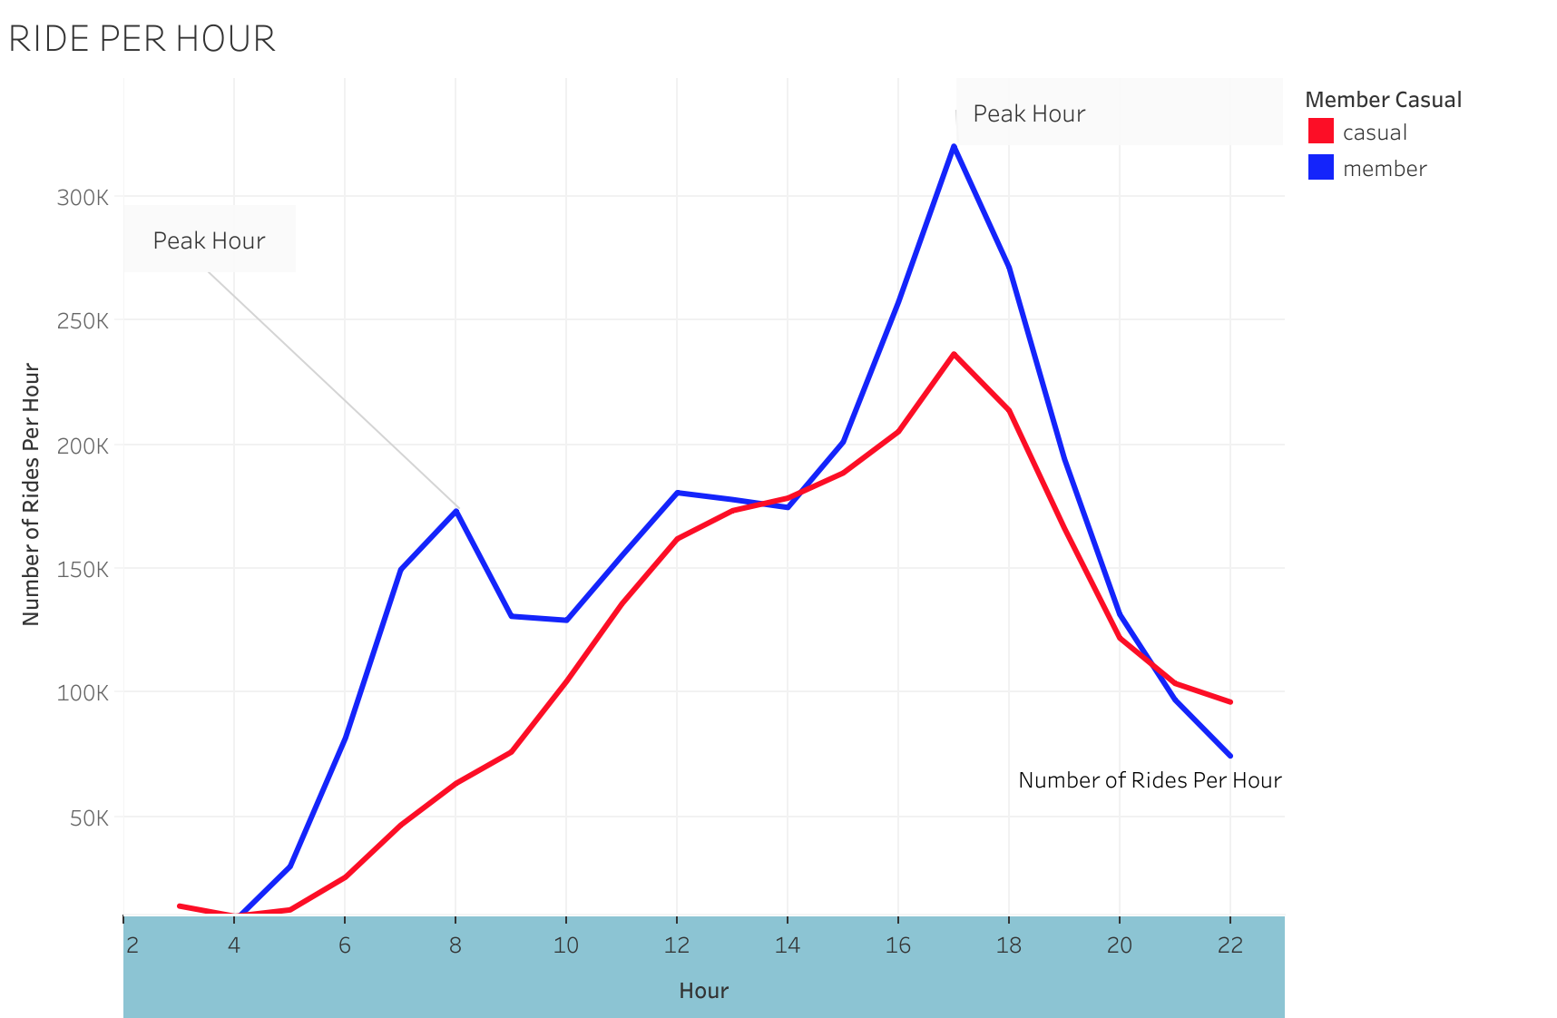
Rides per hour

Slide 9
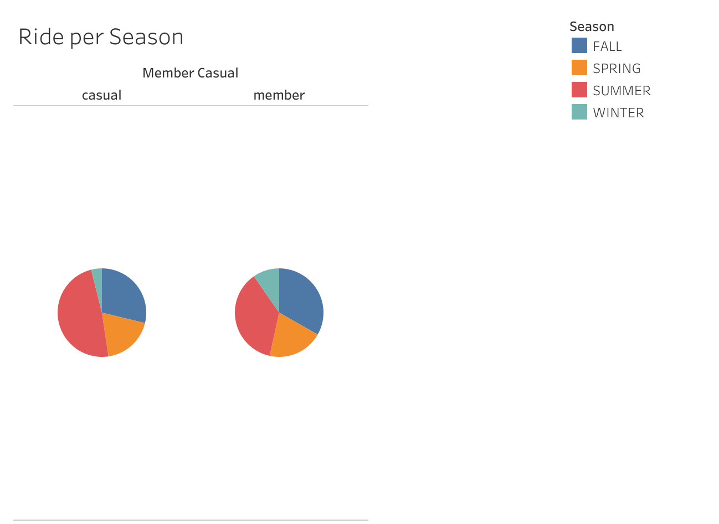
Rides per season

Slide 10

Key findings [summary]
My hypothesis was correct in that casuals use the company’s services for leisure whiles members use the service for commute purpose.
Although casuals ride more frequently and for longer hours, we do not know know enough about the riders [they gender, their race, where they live nor their income] thus we can’t make an informed decisions on how to convert them into members.

Slide 11

Next step
An in-depth research will be required to make an educated recommendations
Given that nothing was mentioned about the difference in services, an introduction of an added service such as pre booking and cleaning rooms after a ride could potentially get casuals to convert to members, considering the cost implication

Slide 12

Source and licensing
The datasets have a different name because Cyclistic is a fictional company.
The data has been made available by Motivate International Inc. under this license.
https://ride.divvybikes.com/data-license-agreement
This is public data that you can use to explore how different customer types are using Cyclistic bikes. But note that data-privacy issues prohibit you from using riders’ personally identifiable information.

